Slide 1
Multiphase performance assessment of Naturally Fractured Reservoirs using EDFM
may 18, 2024
Renato poli

Slide 2
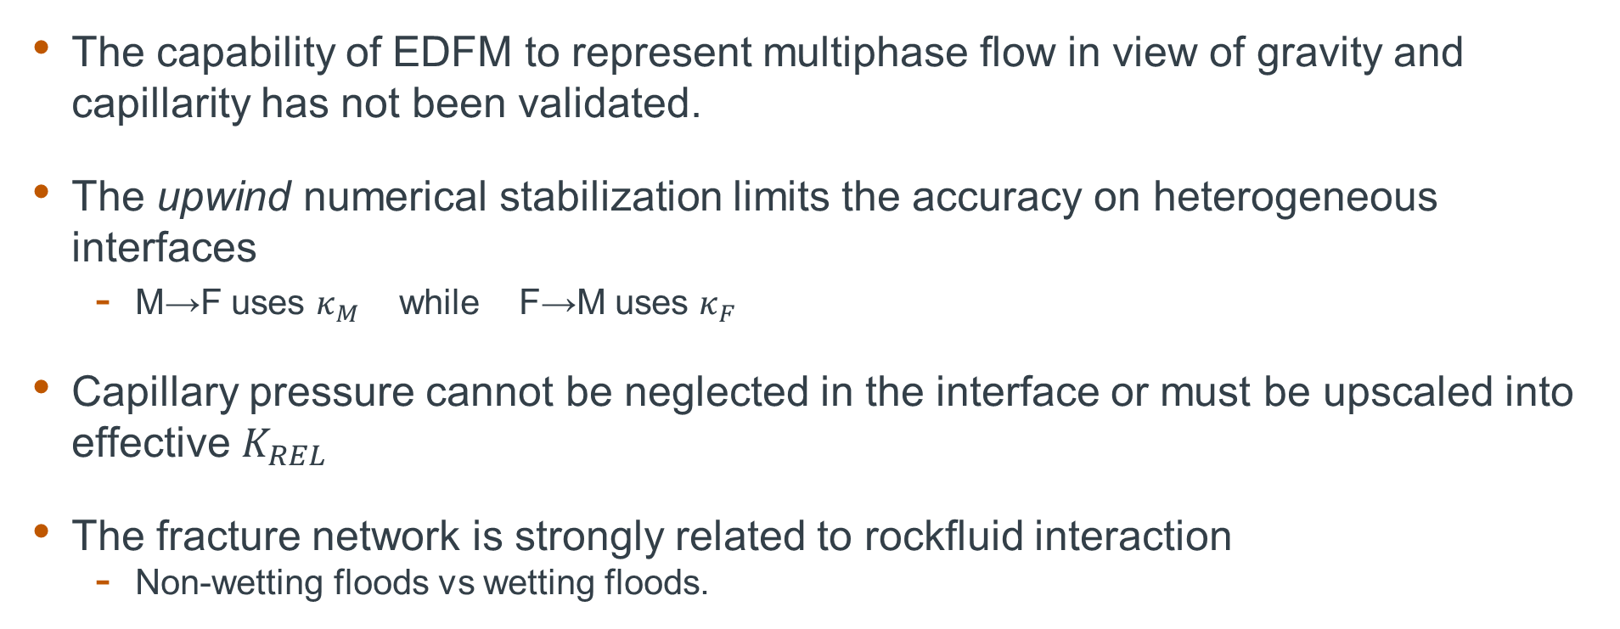
Motivation
The capability of EDFM to represent multiphase flow in view of gravity and capillarity has not been validated.
The upwind numerical stabilization limits the accuracy on heterogeneous interfaces
M→F uses $κ_{M}$ while F→M uses $κ_{F}$
Capillary pressure cannot be neglected in the interface or must be upscaled into effective $K_{REL}$
The fracture network is strongly related to rockfluid interaction
Non-wetting floods vs wetting floods.

Slide 3
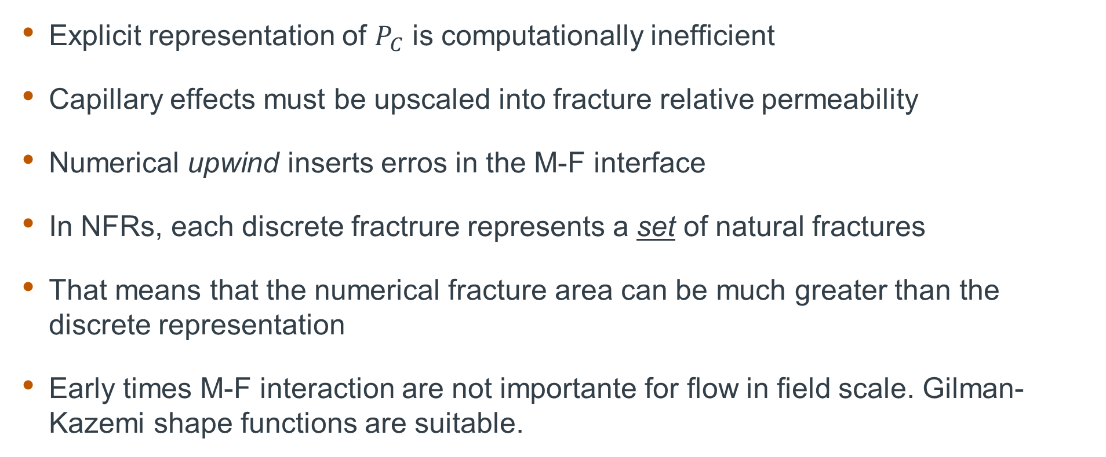
Some hypotheses
Explicit representation of $P_{C}$ is computationally inefficient
Capillary effects must be upscaled into fracture relative permeability
Numerical upwind inserts erros in the M-F interface
In NFRs, each discrete fractrure represents a set of natural fractures
That means that the numerical fracture area can be much greater than the discrete representation
Early times M-F interaction are not importante for flow in field scale. Gilman-Kazemi shape functions are suitable.

Slide 4
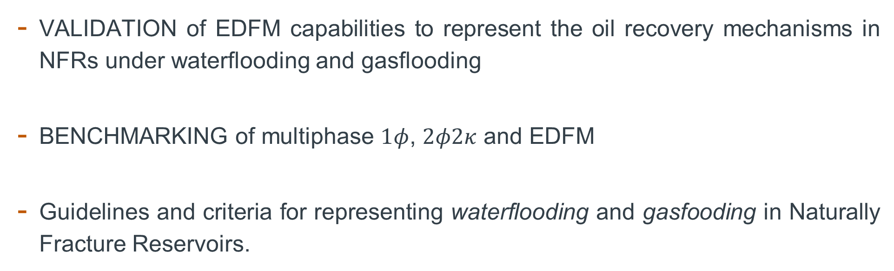
Contributions
VALIDATION of EDFM capabilities to represent the oil recovery mechanisms in NFRs under waterflooding and gasflooding
BENCHMARKING of multiphase $1φ$, $2φ2κ$ and EDFM
Guidelines and criteria for representing waterflooding and gasfooding in Naturally Fracture Reservoirs.

Slide 5
Physical phenomena
Buoyancy
Capillarity
Objective functions
Ultimate oil recovery
Characteristic times

Slide 6
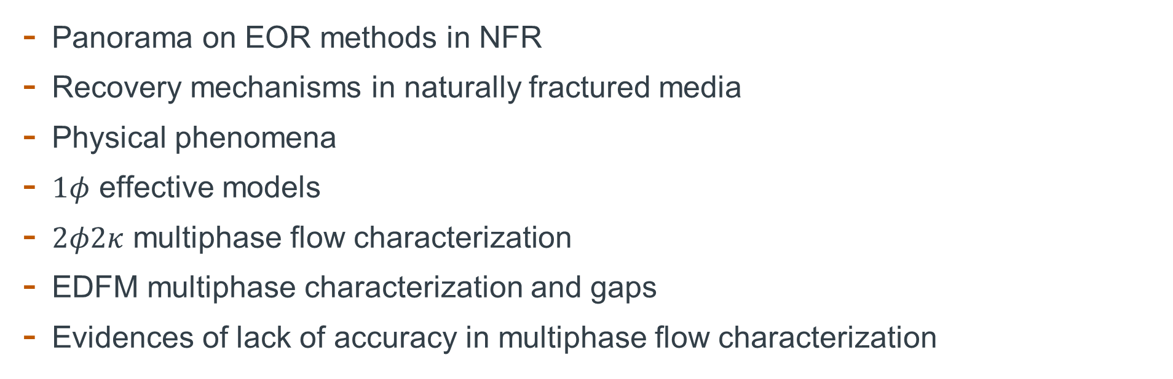
LITERATURE SURVEY
Panorama on EOR methods in NFR
Recovery mechanisms in naturally fractured media
Physical phenomena
$1φ$ effective models
$2φ2κ$ multiphase flow characterization
EDFM multiphase characterization and gaps
Evidences of lack of accuracy in multiphase flow characterization

Slide 7
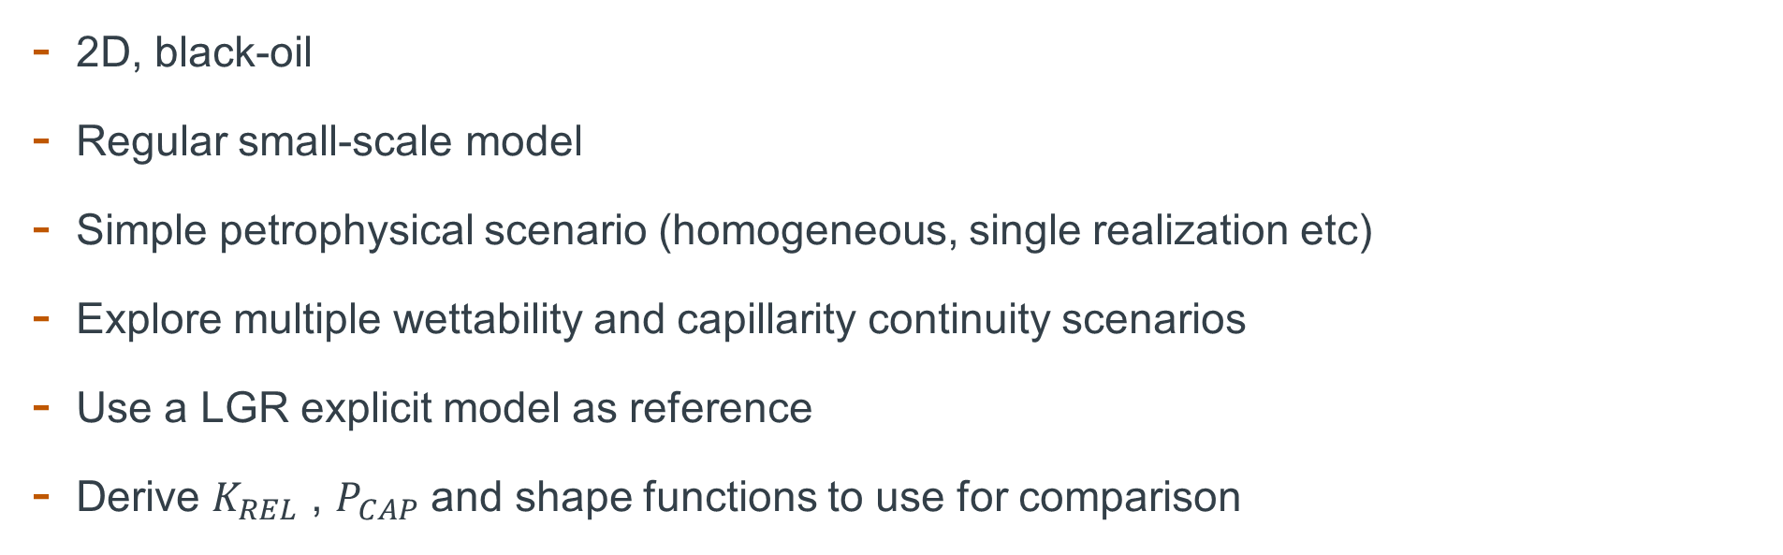
MULTIPHASE FLOW VALIDATION
2D, black-oil
Regular small-scale model
Simple petrophysical scenario (homogeneous, single realization etc)
Explore multiple wettability and capillarity continuity scenarios
Use a LGR explicit model as reference
Derive $K_{REL}$ , $P_{CAP}$ and shape functions to use for comparison

Slide 8
Fracture

Slide 9
Fracture

Slide 10
BENCHMARKING
Homogenous matrix and fracture;
Single geological scenario of fractures;
Model scale suitable for phenomenological investigation;
Injection and production rates suitable for the model scale.

Slide 11
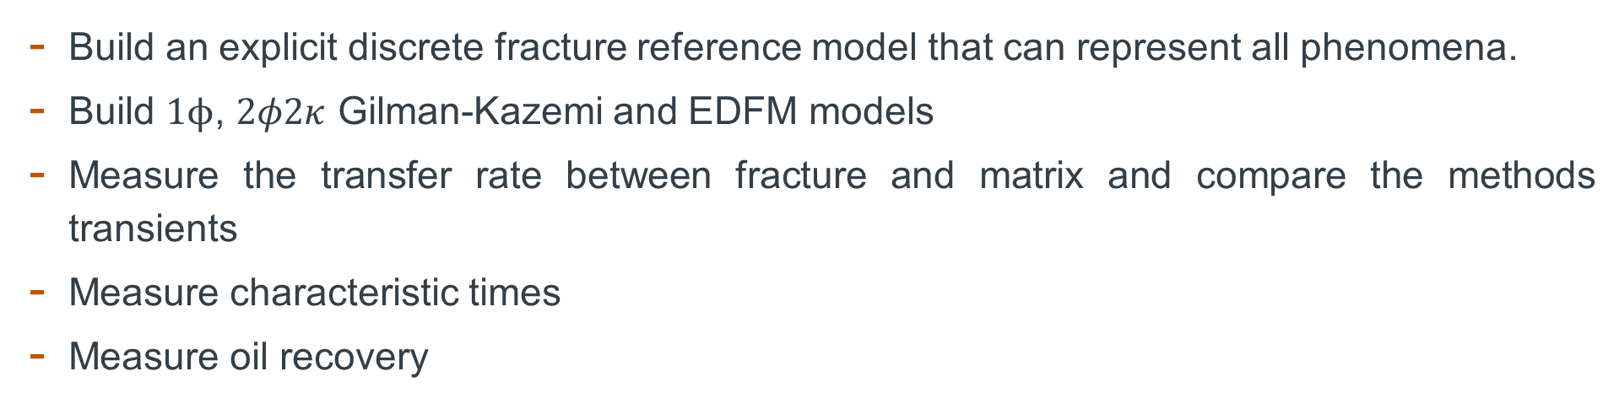
Methodology
Build an explicit discrete fracture reference model that can represent all phenomena.
Build $1ϕ$, $2φ2κ$ Gilman-Kazemi and EDFM models
Measure the transfer rate between fracture and matrix and compare the methods transients
Measure characteristic times
Measure oil recovery

Slide 12
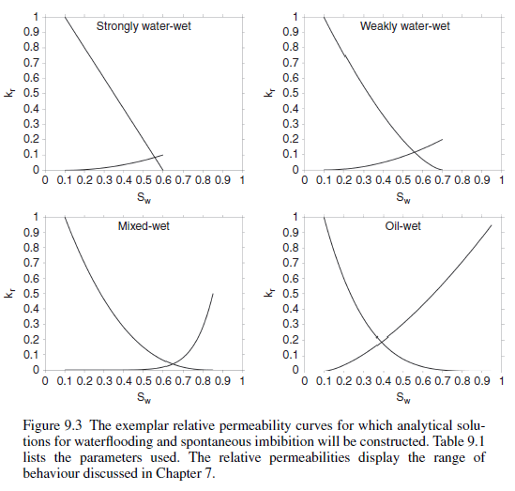
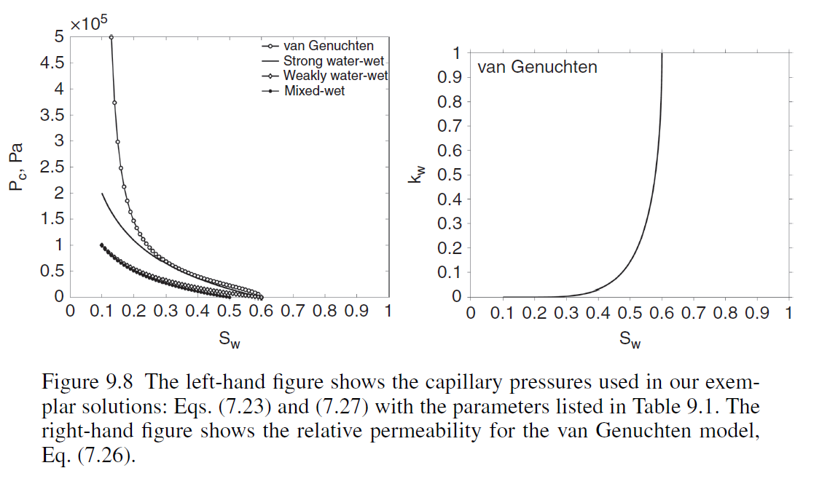
Next steps
Design reference scenarios

